Slide 1
MANTIS
Minimalist Alert Network for Threat Intelligence System
Final Dissertation Presentation
Final Dissertation | CSY4022
Anuskar Sigdel | 24812606
Supervisor: Nischal Khadka | University of Northampton | August 2026
Notes:
[Sources]
- MANTIS_Final_Dissertation_FINAL.docx, cover page and Chapter 1

Slide 2
1. Introduction
Background and rationale
• Small networks face scans, floods, malicious payloads and known-bad sources, but enterprise IDS platforms are costly to configure.
• Existing tools often hide detection logic behind large rule sets or external packages.
• MANTIS provides a transparent host-based NIDS using Python Standard Library components.
• One inspectable pipeline connects capture, detection, evidence and optional response.
• Scope: Linux live capture, offline PCAP replay, five engines and operator-facing reporting.
2
Notes:
[Sources]
- MANTIS_Final_Dissertation_FINAL.docx, Sections 1.1 and 1.2

Slide 3
1.2 Aim and Objectives
What the project set out to deliver
• Aim: design, implement and evaluate a lightweight host-based NIDS using only the Python standard library.
• Capture live Ethernet traffic and support reproducible offline PCAP replay.
• Implement five transparent engines for flood, scan, payload, novelty and reputation detection.
• Train from labelled data and persist compatible engine state as portable JSON.
• Provide CLI, dashboard, SIEM and forensic-report evidence paths.
• Test the complete system and keep active defence explicitly policy-gated.
3
Notes:
[Sources]
- MANTIS_Final_Dissertation_FINAL.docx, Sections 1.2 and 1.3

Slide 4
2. Requirements Engineering
Problem domain, proposed solution and alternatives
• Problem domain: constrained Linux hosts need observable intrusion detection without enterprise infrastructure.
• Proposed solution: combine packet capture, five readable engines, evidence outputs and optional response in MANTIS.
• Snort and Suricata are mature, but require rule management, tuning and external installation.
• Zeek provides rich analysis, but introduces a scripting and deployment learning curve.
• Wazuh provides broad SIEM capability, but adds multiple services and management overhead.
• Decision: build a dependency-free research prototype where every detection path can be inspected.
4
Notes:
[Sources]
- MANTIS_Final_Dissertation_FINAL.docx, problem domain, proposed solution and alternative solutions

Slide 5
2.1 Requirement Specification
Functional and non-functional requirements
• Functional: capture, parse, detect, train, persist, alert, export evidence and replay PCAP files.
• Functional: publish dashboard and SIEM data, with optional iptables response controlled by policy.
• Non-functional: transparent and auditable logic with portable state and bounded storage.
• Non-functional: privacy redaction, safe defaults and no blocking unless explicitly enabled.
• Traceability links every requirement to an implemented component and test evidence.
5
Notes:
[Sources]
- MANTIS_Final_Dissertation_FINAL.docx, functional and non-functional requirements tables

Slide 6
3. Literature Review
6
Notes:
[Sources]
- MANTIS_Final_Dissertation_FINAL.docx, Chapter 2 Literature Review

Slide 7
4. Methodology
Constructive research with Agile and Scrum principles
• Constructive research defined the problem, built the MANTIS artefact, evaluated it and critiqued its limitations.
• Agile and Scrum principles supported short cycles, a prioritised backlog, review and adaptation.
• A Kanban board made work visible across requirements, design, construction, testing and documentation.
• V-model traceability linked requirements to unit, integration, system and evaluation evidence.
• Safety controls used offline datasets, loopback services, privacy redaction and policy-gated response.
7
Notes:
[Sources]
- MANTIS_Final_Dissertation_FINAL.docx, methodology section
- MANTIS methodology-based Gantt chart, March to August 2026

Slide 8
4.1 Methodology in Practice
How the process was implemented in MANTIS
• Problem and requirements: define behaviours, constraints, evidence and safety boundaries.
• Analysis and design: use case, class, activity, sequence and end-to-end workflow models.
• Construction: capture and parser first, then engines, persistence, dispatcher and operator interfaces.
• Verification: run unit, integration and system tests during each iteration.
• Evaluation: controlled engine checks followed by a 63-file CIC-IoT2023 stress test.
• Review: feed defects and evidence limits into corrections, future scope and the dissertation.
8
Notes:
[Sources]
- MANTIS_Final_Dissertation_FINAL.docx, methodology and system build chapters

Slide 9
5. Detection Algorithms
Definition, use and implementation in the system
Algorithm | Definition | Used for | System implementation
Z-Score | Deviation from a running mean | Flood anomaly | Welford statistics, warm-up, z > 3
KNN | Vote among nearest scaled samples | Port scan | Unique ports and packet count against labelled neighbours
Naive Bayes | Class probability over tokens | Malicious payload | Tokenisation and smoothed token likelihoods
K-Means | Distance from learned centroids | Novel behaviour | Online centroids; anomalies do not update the model
Bloom filter | Probabilistic set membership | Known-bad IP | Fixed bit array and multiple hashes loaded from a feed
• All engines emit one Verdict contract, separating detection from alerting and firewall policy.
9
Notes:
[Sources]
- MANTIS_Final_Dissertation_FINAL.docx, detection algorithm definitions and implementation sections

Slide 10
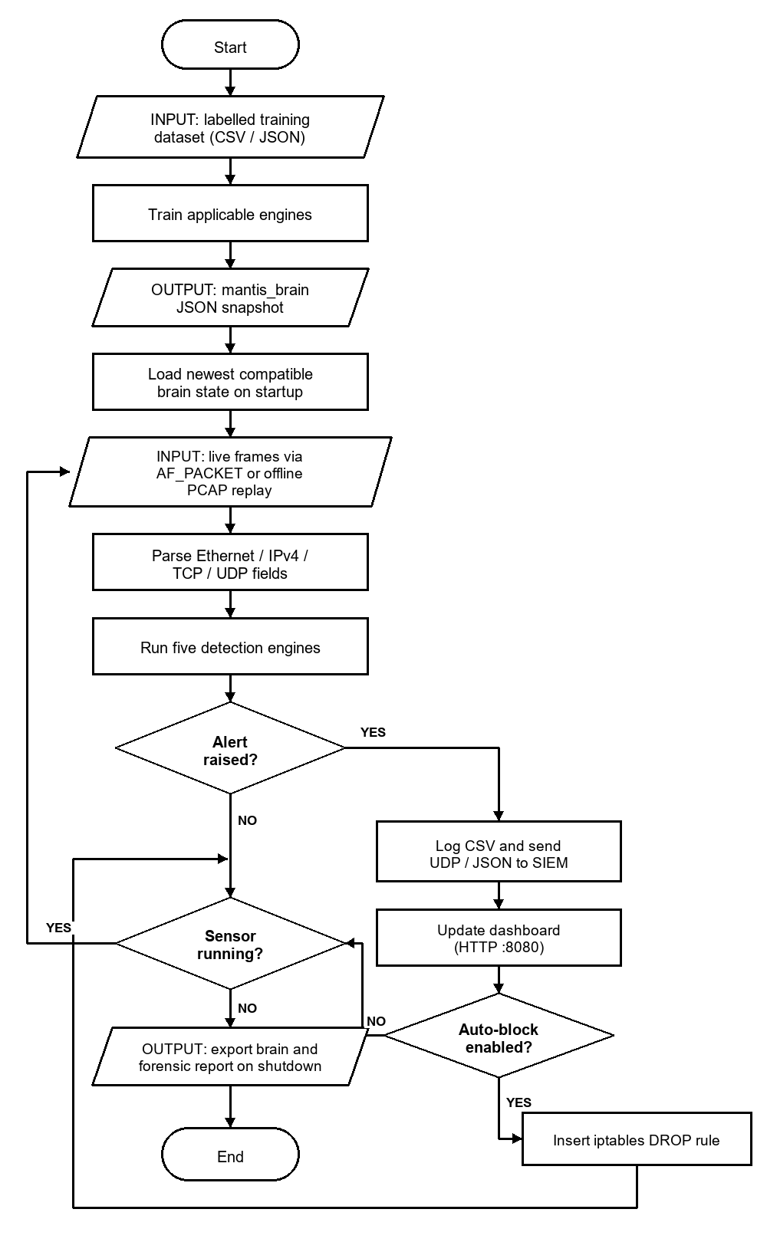
6. System Analysis and Design
Short implementation view
• Actors: administrator, host operating system and external SIEM or browser.
• SensorNode owns capture, parser, five engines and the dispatcher.
• PacketParser validates Ethernet, VLAN, IPv4, TCP, UDP and ICMP fields.
• Dispatcher persists evidence and publishes qualifying alerts.
• ActiveDefense is optional; shutdown exports engine state and the forensic report.
10
Notes:
[Sources]
- MANTIS_Final_Dissertation_FINAL.docx, Chapter 3
- Existing workflow image retained from the source presentation

Slide 11
7. Testing Strategy
How testing was planned and conducted
• Verify specified software behaviour first, then evaluate detection effectiveness separately.
• All 116 automated tests passed on 20 August 2026 in 4.642 seconds.
• Twenty-eight representative cases document expected and actual outcomes with terminal evidence.
• Positive, negative, boundary, malformed-input and regression cases were included.
• Controlled frames, PCAP replay and loopback services avoided attacks on external systems.
• UDP ResourceWarnings are disclosed as test-harness cleanup, not hidden.
11
Notes:
[Sources]
- MANTIS_Final_Dissertation_FINAL.docx, Sections 5.1 and 5.3, Tables 5.1, 5.3 and 5.4

Slide 12
7.1 Unit and Integration Testing
White-box and black-box coverage
• White-box unit tests checked Z-Score mathematics, KNN scaling, Bayes probabilities, K-Means warm-up and Bloom membership.
• White-box module tests checked parser bounds, privacy redaction, configuration, risk mapping and packet storage.
• Integration tests followed parser-to-engine flow, dispatcher fan-out, state round trips and duplicate suppression.
• Black-box system tests exercised UDP and HTTP SIEM endpoints, filtering, malformed datagrams and PCAP export.
• Actual outcomes matched the expected outcomes for cases TC-01 to TC-28.
12
Notes:
[Sources]
- MANTIS_Final_Dissertation_FINAL.docx, testing definitions and representative test cases

Slide 13
7.2 Algorithm-Specific Testing
Each algorithm requires its own decision checks
• Z-Score: warm-up, spike threshold, sustained flood and baseline-poisoning protection.
• KNN: scaled features, normal browsing, flood-versus-scan separation and low-volume scans.
• Naive Bayes: benign HTTP, malicious tokens and an obfuscated payload case.
• K-Means: warm-up, familiar points, novelty distance and protection from centroid poisoning.
• Bloom filter: feed loading, membership, saturation and no false negatives for inserted indicators.
• The suite tests each decision rule directly instead of applying one generic accuracy script.
13
Notes:
[Sources]
- MANTIS_Final_Dissertation_FINAL.docx, Section 5.2 Algorithm Tests

Slide 14
8. Results and Findings
Controlled checks verified implementation, not field accuracy
Engine | N | Scenario | Outcome | Limit | Meaning
KNN | 40 | Port scan | Matched | Small set | Path check
Naive Bayes | 24 | Payload | R .9167; F1 .9565 | 1 miss | Metric check
Z-Score | 40 | Flood | Matched | Constructed | Path check
K-Means | 44 | Novelty | Matched | Small vectors | Path check
Bloom | 25 | Bad IP | Inserted found | Property only | Set check
• Small engine-specific samples verify code paths and expected decisions.
• Perfect values on matched constructed sets are not presented as deployment performance.
14
Notes:
[Sources]
- MANTIS_Final_Dissertation_FINAL.docx, controlled algorithm-test discussion preceding Table 5.2

Slide 15
8.1 External Dataset Evaluation
CIC-IoT2023: 63 files, 45,018,252 rows, 9.30 GB
Evaluation scope | Rows | Precision | Recall | F1 | MCC
All merged files | 45,018,252 | .997417 | .043619 | .083582 | .029049
Benign + DoS/DDoS | 41,333,350 | .997302 | .045574 | .087165 | .031179
Always-positive baseline | 45,018,252 | .976647 | 1.000000 | .988186 | 0.000000
Missed attack rows | 42,049,152 |  | 95.64% missed
Compatible feature | Rate only
• Only Rate matched the external files, so this is a Z-Score transfer stress test, not a five-engine benchmark.
• High precision concealed very low recall; the fixed three-sigma rule did not transfer to heavy-tailed flow data.
15
Notes:
[Sources]
- MANTIS_Final_Dissertation_FINAL.docx, Table 5.2 and external CIC-IoT2023 evaluation discussion

Slide 16
9. Conclusion
• MANTIS meets its aim as an inspectable lightweight research prototype.
• Five engines integrate with live capture, replay, persistence, SIEM, dashboard and policy-gated response.
• Evidence includes 116 tests, 28 traced cases and a 45-million-row external stress test.
• The main finding is that sound software behaviour does not guarantee field accuracy without calibration and domain-matched temporal data.
• MANTIS is a transparent baseline for constrained hosts and teaching, not an enterprise IDS replacement.
Transparent implementation, honest evidence, clear next steps
16
Notes:
[Sources]
- MANTIS_Final_Dissertation_FINAL.docx, Chapter 7 Conclusion

